Slide 1
Describing Data
Analysis of Biological Data
Chapter 3

Slide 2
Key Learning Objectives
Differentiate between estimates of location and estimates of width.
Recognize that variability is not simply noise, but is a key parameter that can be estimated.
Become familiar with the most common descriptive statistics.
Know when the mean or median is a more appropriate summary of location.

Slide 3
Three Common Descriptions of Data
Location (central tendency)
Width (spread)
Association* (correlation)
*later in term

Slide 4
Samples and Populations
We do statistics to learn about the
World Out There (the population)
From
Data (the sample)

Slide 5
Estimates and Parameters
We almost never sample an entire population. So we can’t nail down parameters from populations.
But we can make educated guesses of parameters by making estimates from samples.

Slide 6
Measures of Location: Mean, Median, Mode

Slide 7
Histograms Reveal Location

Slide 8
The ✌️Average ✌️
NOTE: The word, “Average”, is imprecise.
“Average” is often used synonymously with mean.
However medians and even modes are sometimes called an “Average”.
When you see the word, “Average”, pay attention to which measure of location it describes.

Slide 9
Mean, Median, Mode
Mean: The sum of values divided by sample size.
The weight of the data.
Median: The middle measurement.
If I take an individual at random, this is the value we expect them to be closest to.
Mode: The most common individual.
The most common value for an individual

Slide 10
Measures of Location The mean

Slide 11
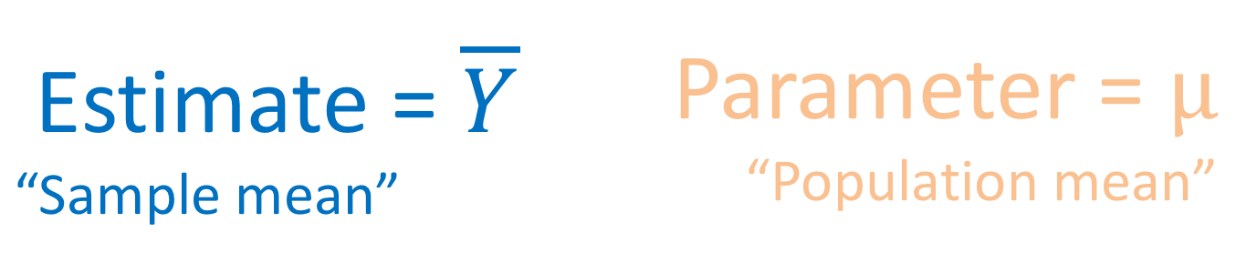
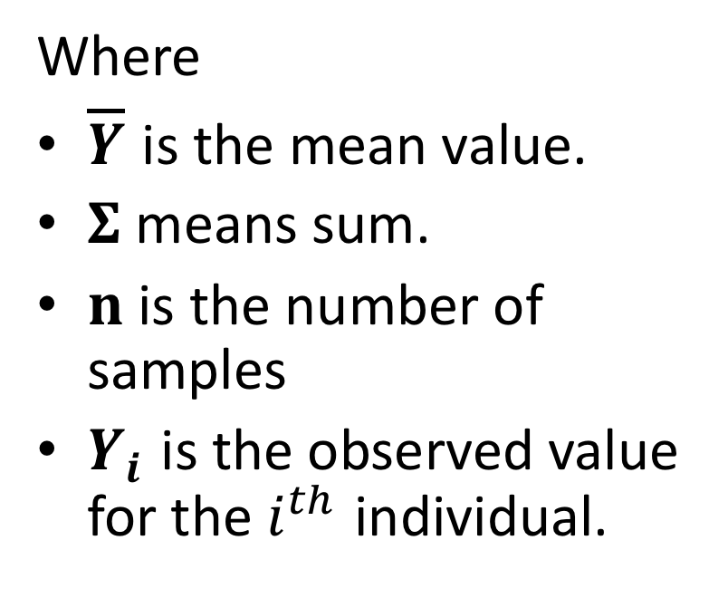
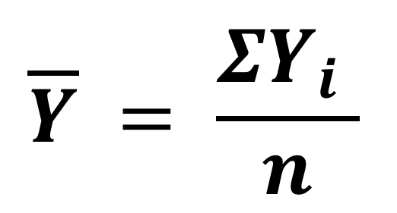
Mean
Estimate = $\overline{Y}$ “Sample mean” | Parameter = $μ$ “Population mean”
Where
$\overline{Y}$ is the mean value.
$Σ$ means sum.
$n$ is the number of samples
$Y_{i}$ is the observed value for the $i^{th}$ individual.
$$\overline{Y} = \frac{ΣY_{i} }{n}$$

Slide 12
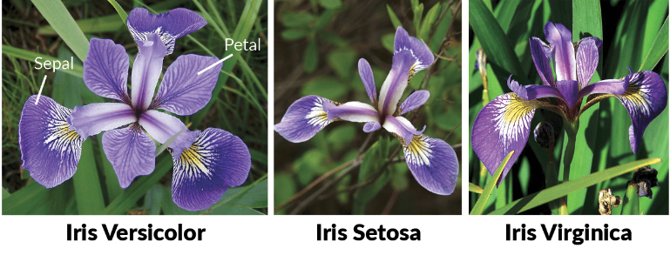
Mean: An Example from R
The mean: The sum of all observations divided by the sample size.
iris %>%
group_by(Species) %>%
summarize(mean.by.math = sum(Petal.Width)/n() ,
mean.by.function = mean(Petal.Width))
## Species mean.by.math mean.by.function
## 1 setosa 0.25 0.25
## 2 versicolor 1.33 1.33
## 3 vriginica 2.03 2.03

Slide 13
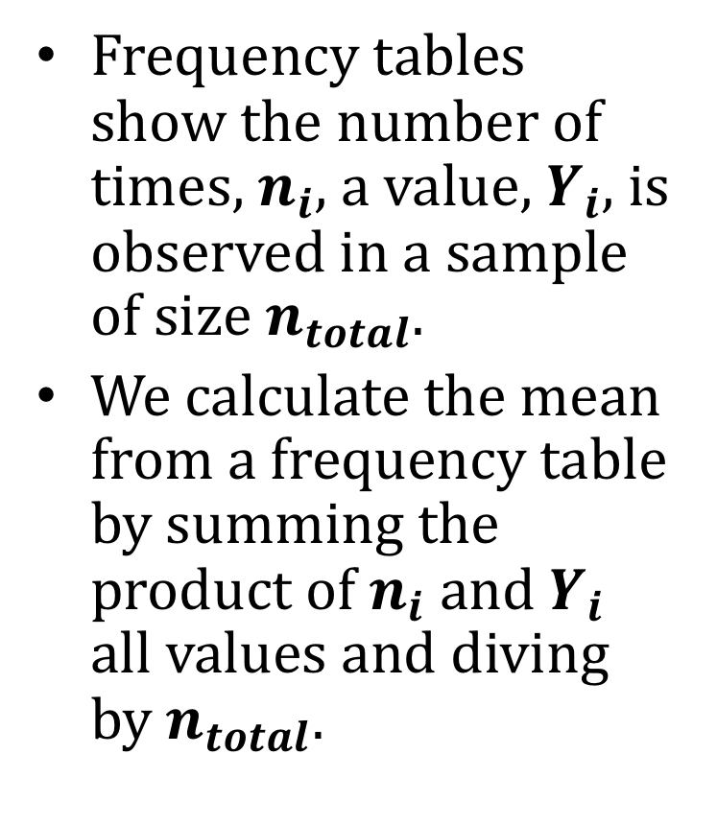
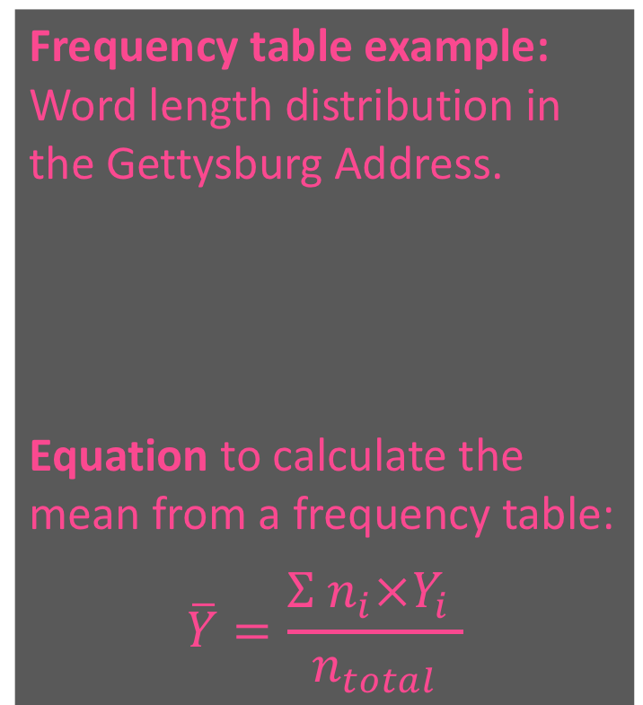
Calculating a Mean From a Freq. Table
Frequency tables show the number of times, $n_{i},$ a value, $Y_{i}$, is observed in a sample of size $n_{total}$.
We calculate the mean from a frequency table by summing the product of $n_{i}$ and $Y_{i}$ all values and diving by $n_{total}$.
Frequency table example:
Word length distribution in the Gettysburg Address.
Equation to calculate the mean from a frequency table:
$$\overline{Y}=\frac{Σ n_{i}×Y_{i} }{n_{total}}$$
Word length | 1 | 2 | 3 | 4 | 5 | 6 | 7 | 8 | 9 | 10 | 11
count | 7 | 50 | 60 | 58 | 34 | 24 | 15 | 6 | 10 | 4 | 2

Slide 14
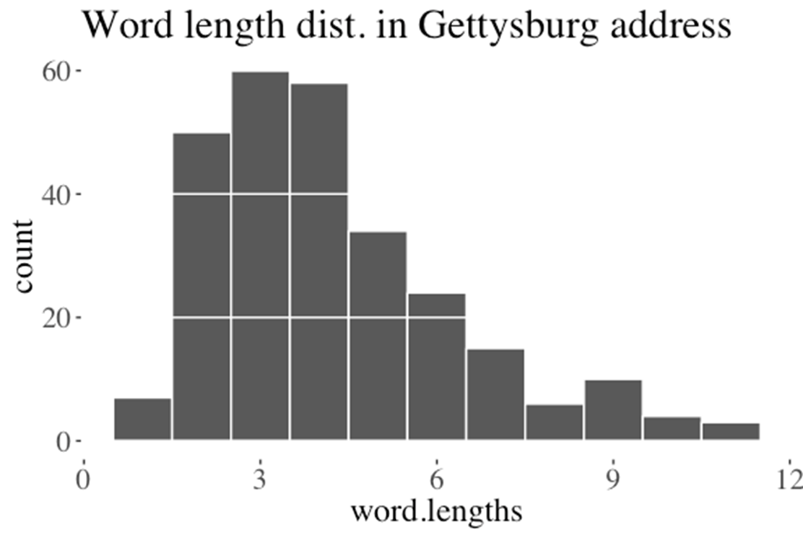
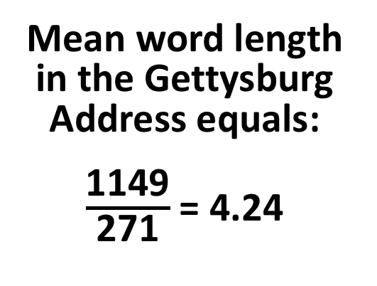
Mean From a Frequency Table: Example
Word Length | Count
1 | 7
2 | 50
3 | 60
4 | 58
5 | 34
6 | 24
7 | 15
8 | 6
9 | 10
10 | 4
11 | 2
Numerator | Denominator
1 x 7 + | 7 +
2 x 50 + | 50 +
3 x 60 + | 60 +
4 x 58 + | 58 +
5 x 34 + | 34 +
6 x 24 + | 24 +
7 x 15 + | 15 +
8 x 6 + | 6 +
9 x 10 + | 10 +
10 x 4 + | 4 +
11 x 2 | 2
1149 | 271
Mean word length in the Gettysburg Address equals:
$\frac{\text{1149}}{\text{271}}$ = 4.24

Slide 15
Measures of Location The median

Slide 16
The Median
The median is the middle measurement of a sample.
Calculate the median by taking the value halfway through an ordered list of observations.
This is the mean of n / 2th and the (n + 2) / 2th value for even sized samples.
This is the (n + 1) / 2th value for odd sized samples.

Slide 17
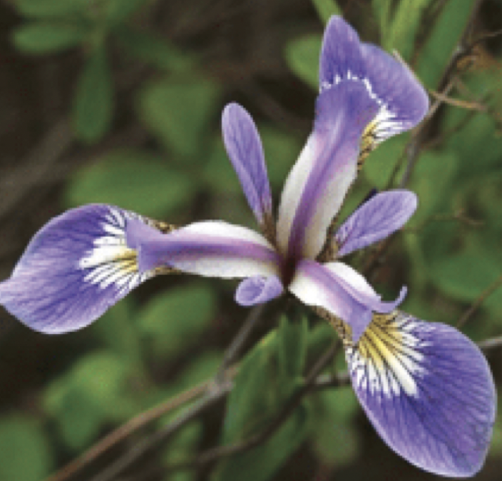
Median Example
The median Iris setosa sepal length is 5.0.
We find this by taking the mean of the 25th and 26th of 50 ordered sepal lengths.
iris %>%
filter(Species == "setosa") %>%
select(Sepal.Length) %>%
arrange(Sepal.Length)
[1] 4.3 4.4 4.4 4.4 4.5 4.6 4.6 4.6 4.6 4.7 4.7 4.8 4.8
[14] 4.8 4.8 4.8 4.9 4.9 4.9 4.9 5.0 5.0 5.0 5.0 5.0 5.0
[27] 5.0 5.0 5.1 5.1 5.1 5.1 5.1 5.1 5.1 5.1 5.2 5.2 5.2
[40] 5.3 5.4 5.4 5.4 5.4 5.4 5.5 5.5 5.7 5.7 5.8

Slide 18
Which to Use? Mean or Median?
The mean is more convenient mathematically. The mean is the center of gravity.
The mean is simply related to the sum of all observations and the sample size.
The median describes the average individual. The median is the middle measurement.
The median is less moved by extreme values.
The mean and median become the same when data are symmetric.

Slide 19
Mean or Median? Consider Skewedness
Few small values.
> 1/2 of values exceed the mean.
As many large as small values.
~ 1/2 of values exceed the mean.
Few large values.
> 1/2 of values are less than the mean.
For measures like income, medians are generally preferable to means.
This is because populations are right-skewed (there are few very rich people), and we care more about the average person than the average of people.

Slide 20
Example: Mean or Median?
The number of seeds per fruit is right-skewed.
Which description of location is better – mean, or median?

Slide 21
Measures of Location The mode

Slide 22
The Mode
The mode is the most common observation in a sample.
The mode is easy to pick out visually as the peak in a histogram.

Slide 23
The width of the data

Slide 24
Width (aka Variability)
Variability of a population should not be ignored as simply noise about the mean, but is biologically important in its own right.
Variation has a true value from a population that we estimate from a sample.

Slide 25
Measures of Width
Range: The difference between the largest and smallest values.
Interquartile Range: The difference between the 25th and 75th percentile.
Variance & Standard Deviation: The difference between a random sample & the mean.
Coefficient of Variation: A measure of the standard deviation that’s independent of the mean.

Slide 26
Measures of Width Range and Interquartile Range

Slide 27
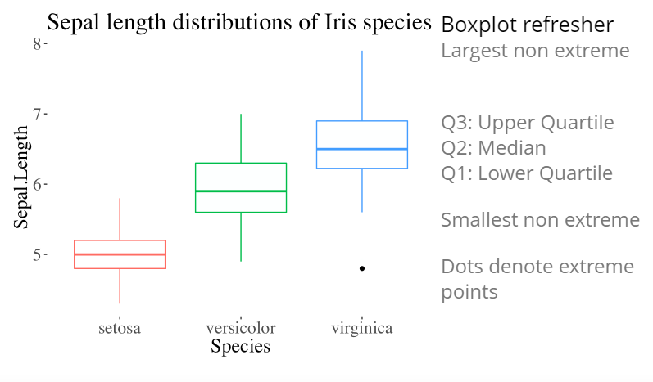
Boxplots Display Ranges & Quartiles

Slide 28
Range
Range: The difference between extreme values. It is not a great measure of width.
Because small samples tend to give lower estimates of the range than large samples, the sample range is a biased estimator of the true range of the population.
Largest Value
minus
Smallest Value

Slide 29
Range Example
Range of Iris setosa sepal length = 5.8 - 4.3 = 1.5.
[1] 4.3 4.4 4.4 4.4 4.5 4.6 4.6 4.6 4.6 4.7 4.7 4.8 4.8
[14] 4.8 4.8 4.8 4.9 4.9 4.9 4.9 5.0 5.0 5.0 5.0 5.0 5.0
[27] 5.0 5.0 5.1 5.1 5.1 5.1 5.1 5.1 5.1 5.1 5.2 5.2 5.2
[40] 5.3 5.4 5.4 5.4 5.4 5.4 5.5 5.5 5.7 5.7 5.8
Largest
5.8
minus
minus
-------
1.5
Smallest
4.3

Slide 30
The Interquartile Range
Imagine sorting your data.
The individual in the middle is the median.
The first and last individuals mark the range
The other two quantiles are the individuals ¼ and ¾ the way into your sorted list of data
The difference between these is the interquartile range
This measure is less biased than the range.
75th percentile
minus
25th percentile

Slide 31
Interquartile Range (IQR) Example
IQR of Iris setosa sepal length = 5.2 – 4.8 = 0.4.
[1] 4.3 4.4 4.4 4.4 4.5 4.6 4.6 4.6 4.6 4.7 4.7 4.8 4.8
[14] 4.8 4.8 4.8 4.9 4.9 4.9 4.9 5.0 5.0 5.0 5.0 5.0 5.0
[27] 5.0 5.0 5.1 5.1 5.1 5.1 5.1 5.1 5.1 5.1 5.2 5.2 5.2
[40] 5.3 5.4 5.4 5.4 5.4 5.4 5.5 5.5 5.7 5.7 5.8
75th percentile
5.2
minus
minus
--------
0.4
25th percentile
4.8

Slide 32
Measures of Width Variance, Standard Deviation, and Coefficient of Variation

Slide 33
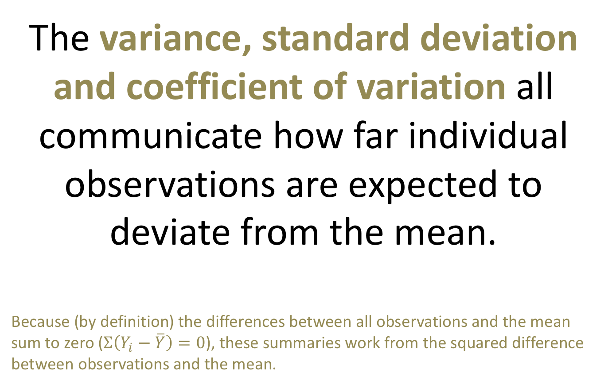
Variance, Standard Deviation, & Coef. of Variation
The variance, standard deviation and coefficient of variation all communicate how far individual observations are expected to deviate from the mean.
Because (by definition) the differences between all observations and the mean sum to zero ($Σ\left(Y_{i}−\overline{Y}\right)=0$), these summaries work from the squared difference between observations and the mean.

Slide 34
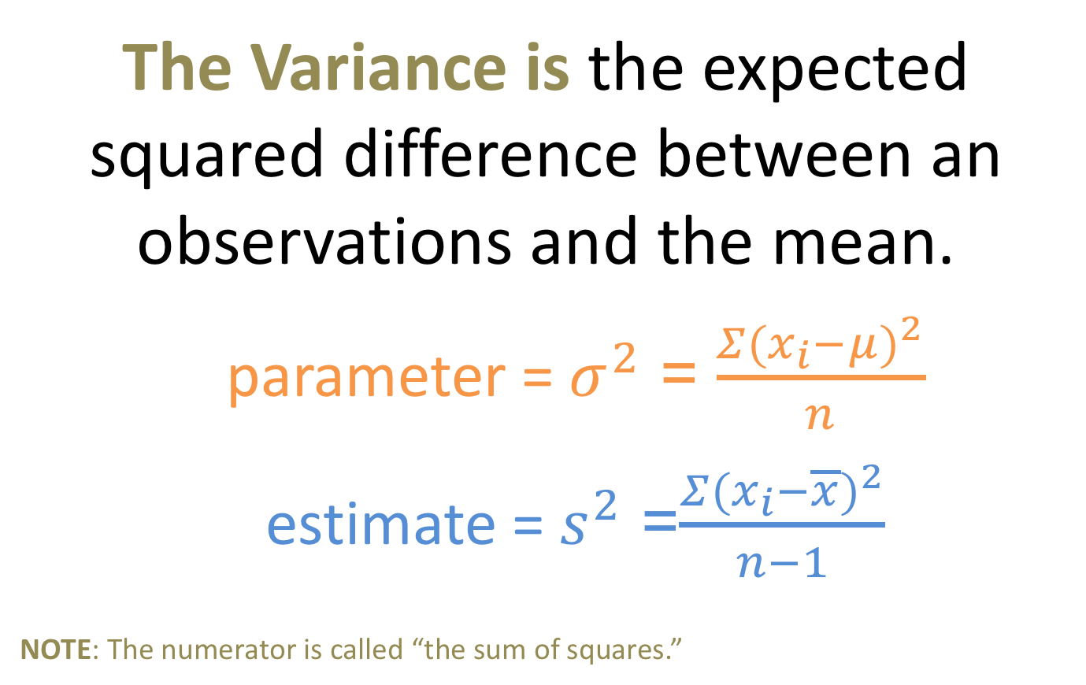
The Variance
The Variance is the expected squared difference between an observations and the mean.
parameter = $σ^{2}$ = $\frac{Σ(x_{i}−μ)^{2}}{n}$
estimate = $s^{2}$ =$\frac{Σ(x_{i}−\overline{x})^{2}}{n−1}$
NOTE: The numerator is called “the sum of squares.”

Slide 35
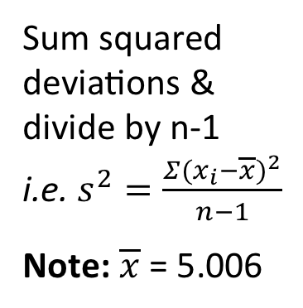
Sample Variance of Iris setosa Sepal Lengths
Sum squared deviations & divide by n-1
i.e. $s^{2}=\frac{Σ(x_{i}−\overline{x})^{2}}{n−1}$
Note: $\overline{x}$ = 5.006
+(4.6-5.006)²
+(4.7-5.006)²
+(4.7-5.006)²
+(4.8-5.006)²
+(4.8-5.006)²
+(4.8-5.006)²
+(4.8-5.006)² +(4.8-5.006)²
+(4.9-5.006)²
+(4.9-5.006)²
+(4.9-5.006)²
+(4.9-5.006)²
+(5.0-5.006)²
+(5.0-5.006)²
+(5.0-5.006)²
+(5.0-5.006)²
+(5.0-5.006)²
+(5.0-5.006)²
+(5.0-5.006)²
+(5.0-5.006)²
+(5.1-5.006)²
+(5.1-5.006)² +(5.1-5.006)²
+(5.1-5.006)²
+(5.1-5.006)²
+(5.1-5.006)²
+(5.1-5.006)²
+(5.1-5.006)²
+(5.2-5.006)²
+(5.2-5.006)²
+(5.2-5.006)²
+(5.3-5.006)²
+(5.4-5.006)²
+(5.4-5.006)²
+(5.4-5.006)²
+(5.4-5.006)²
+(5.4-5.006)²
+(5.5-5.006)²
+(5.5-5.006)²
+(5.7-5.006)²
+(5.7-5.006)²
+(5.8-5.006)²
6.0882/(50-1)
= 0.124
(4.3-5.006)²
+(4.4-5.006)²
+(4.4-5.006)²
+(4.4-5.006)²
+(4.5-5.006)²
+(4.6-5.006)²
+(4.6-5.006)²
+(4.6-5.006)²

Slide 36
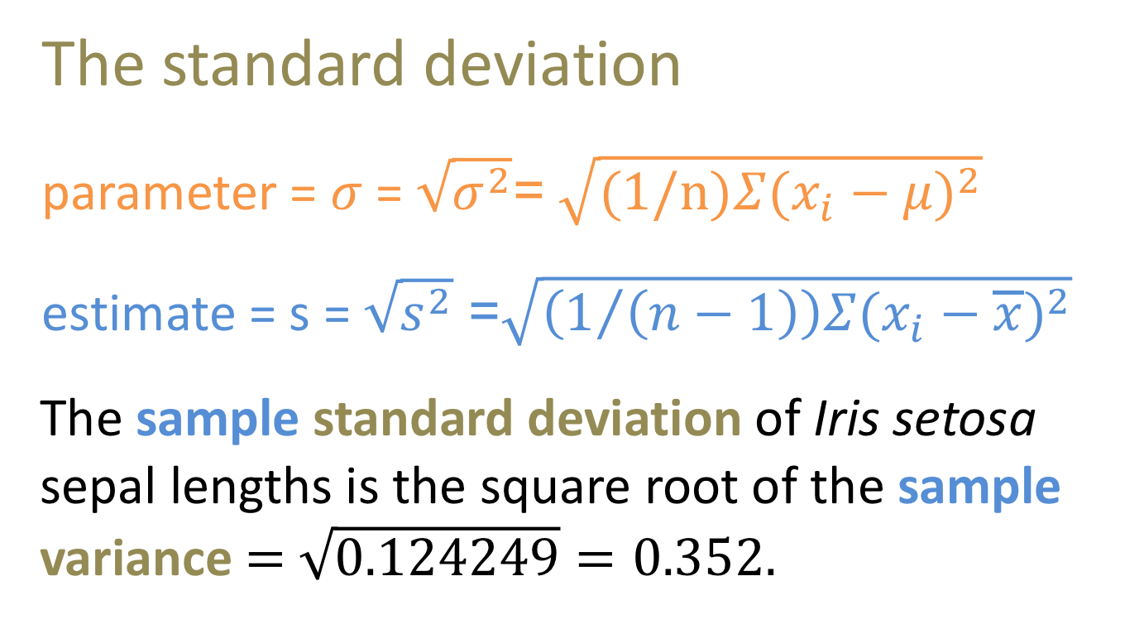

Standard Deviation = $\sqrt{Variance}$
The standard deviation
parameter = $σ$= $\sqrt{σ^{2}}$= $\sqrt{(1/n)Σ(x_{i}−μ)^{2}}$
estimate = s = $\sqrt{s^{2}}$ =$\sqrt{\left(1/{\left(n−1\right)}\right)Σ(x_{i}−\overline{x})^{2}}$
The sample standard deviation of Iris setosa sepal lengths is the square root of the sample variance = $\sqrt{\text{0.124249}}=0.352$.

Slide 37
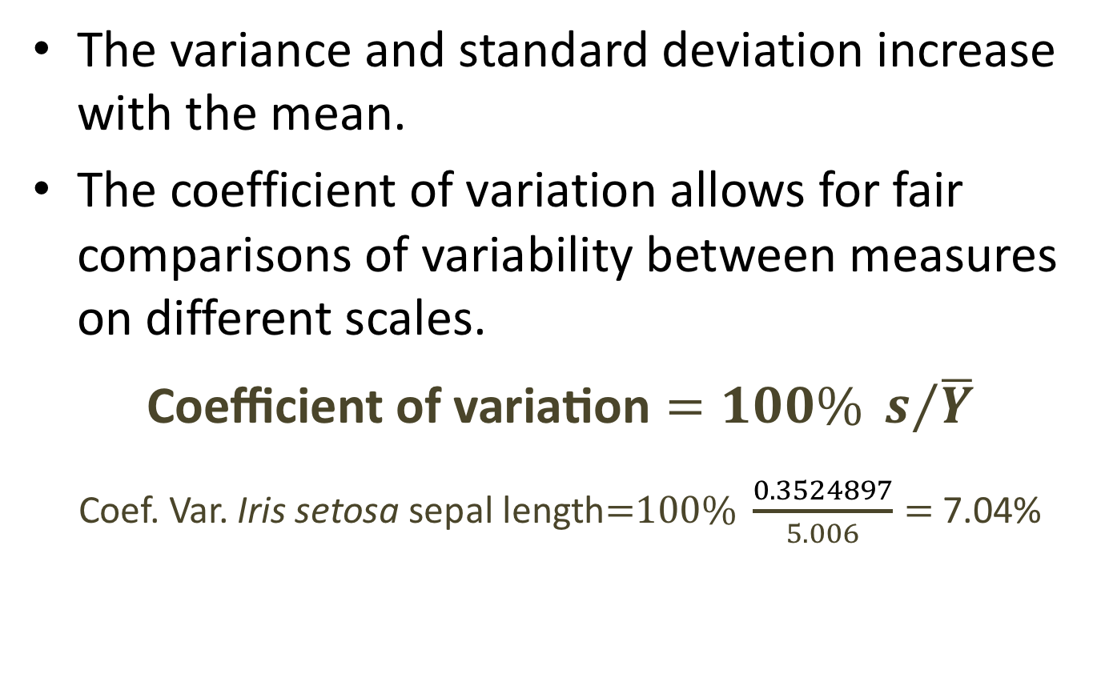
Coefficient of Variation
The variance and standard deviation increase with the mean.
The coefficient of variation allows for fair comparisons of variability between measures on different scales.
$$\text{Coefficient} \text{of} \text{variation}=100\% s/{\overline{Y}}$$
Coef. Var. Iris setosa sepal length=$100\% \frac{0.3524897}{5.006}=$ 7.04%

Slide 38
Variance, Standard Deviation or Coefficient of Variation?
When to use which measure of width?
The variance and standard deviation convey the same information and are used in many equations. Report whichever you like,
Be sure you’re clear, and use the appropriate parameter for your application.
The coefficient of variation is less directly used in equations, but is idea for comparing variation between different types of comparisons.
Use the coefficient of variation to answer questions such as “Is human weight or speed more variable?” or “Which is greater, the variation in apple or orange mass?”

Slide 39
Rounding numbers

Slide 40
Rounding: When and how much?
Computers can return values with precision that exceeds biological interest.
When sharing results, round numbers to a reasonable number of significant figures.
Presenting one or two more digits than initially measured is a good rule of thumb.
🚨DO NOT 🚨 round while calculating or sharing intermediate results!
Round only the final results of the specific summaries of interest.

Slide 41
Dealing with yes/no data

Slide 42
Yes = 1, No = 0
Summarize binary categorical variables by setting the value of one of them (e.g. yes) to 1, and the other (e.g. no) to 0.
The proportion is then the mean (the sum of all ones and zeros divided by n).
Proportion Example: If four dentists recommend a certain brand of gum and a fifth does not, the proportion of dentists recommending it equals (1+1+1+1+0)/5 = .8

Slide 43
How sample size influences estimates

Slide 44
Good Estimators are Unbiased
The expected value of an unbiased estimator equals the population parameter.
Biased estimators are should be avoided.
Biased estimators (often) change with the sample size.
The sample variance and sample standard deviation are divided by (n – 1), rather than n to minimize bias.
The range is a bad summary statistic because it is biased, and increases with sample size.

Slide 45
Unbiased Estimators Do not Change with n
The expected value of unbiased estimator does not change with sample size.

Slide 46
Sampling Error Decreases with Sample Size
Noise in estimates decrease with sample size. Thus increased sample size increases precision.

Slide 47
Review and Nomenclature

Slide 48
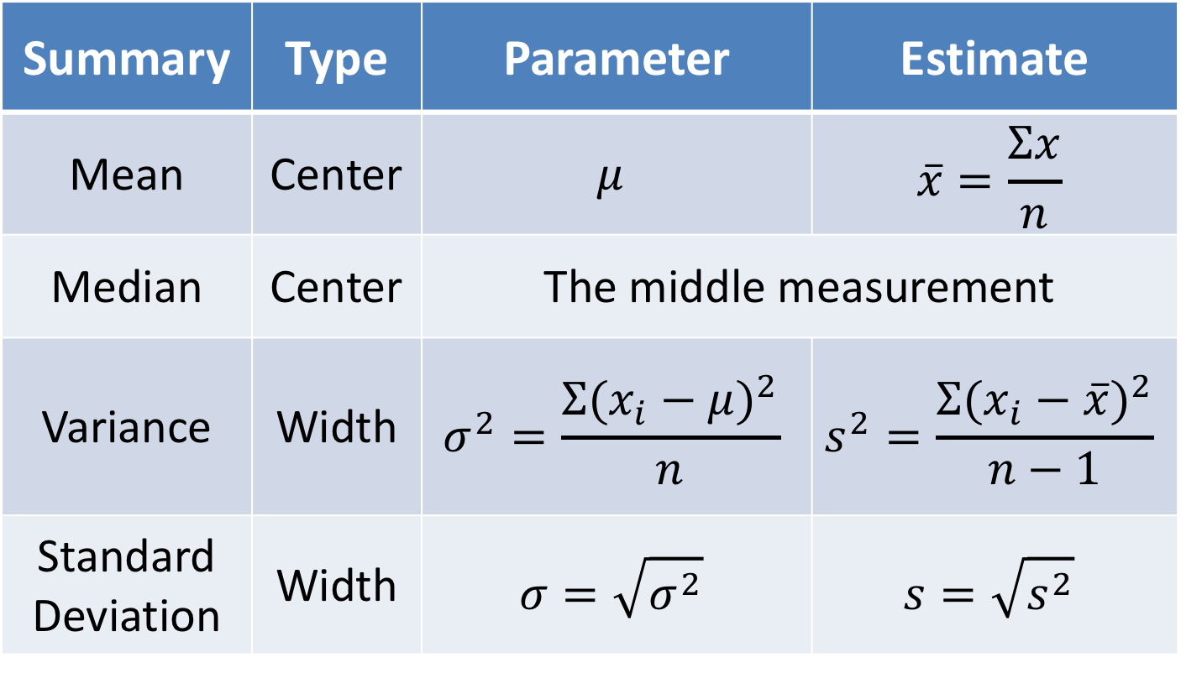
The Most Critical Summaries
Summary | Type | Parameter | Estimate
Mean | Center | $$μ$$ | $$\overline{x}=\frac{Σx}{n}$$
Median | Center | The middle measurement
Variance | Width | $$σ^{2}=\frac{Σ({x_{i}−μ)}^{2}}{n}$$ | $$s^{2}=\frac{Σ({x_{i}−\overline{x})}^{2}}{n−1}$$
Standard Deviation | Width | $$σ=\sqrt{σ^{2}}$$ | $$s=\sqrt{s^{2}}$$

